Slide 1
Chat Connect – A real time Chat And Communication App
B.Gayathri-812022205013

Slide 2
DESCRIPTION
The title “Chat Connect” suggests an application focused on enabling real-time communication, likely designed to connect users through text-based conversation.
It implies a seamless way for people to engage with each other, whether in casual or group chat settings.
The word “Connect” emphasizes the goal of fostering connections between individuals or communities, making it a fitting name for a chat app that facilitates interaction and communication.
The title also conveys a modern and straightforward approach, emphasizing functionality and ease of use.
The simplicity of the name makes it easy to remember and gives the app a broad appeal.
It Reflects the growing importance of digital communication platforms in today’s interconnected world.

Slide 3
Initial Steps
Step 1:
Set up Firebase in your Android Project 1. Go to Firebase Console: Firebase Console, and create a new project. 2. Add Firebase to theAndroid app:
Step 2:
Set Up Firebase Realtime Database In the Firebase Console: Go to Realtime Database and create a new database. Set the database rules temporarily to public for testing (don’t forget to change this for production)
Step 3:
Implement MainActivity.kt Here is the code for MainActivity.kt to set up a simple chat interface where users can send and receive messages.
Step 4:
Set Up XML Layout (activity_main.xml) Create a basic layout with an EditText for message input, a Button to send the message, and a TextView to display messages.

Slide 4
Step 5:
Run the Application 1. Build and run the app on an emulator or physical device. 2. Type a message and press “Send”. The message should appear in the TextView, and you’ll see it stored in Firebase Realtime Database.
Key points:
Real-time Updates: The addValueEventListener in MainActivity.kt listens for changes in Firebase, so messages update in real-time. Security Rules: For production, replace Firebase’s open rules with user-authenticated rules. Authentication: For more advanced use, consider adding Firebase Authentication to allow users to log in and send messages under their profiles.

Slide 5
Program Code:
#Groovy
// Project-level build.gradle file dependencies { classpath ‘com.google.gms:google-services:4.3.10’ // Firebase services } // App-level build.gradle file apply plugin: ‘com.google.gms.google-services’ dependencies { implementation ‘com.google.firebase:firebase-auth:21.0.8’ implementation ‘com.google.firebase:firebase-database:20.1.0’ }
#Json
{ “rules”: { “.read”: “true”, “.write”: “true” } }

Slide 6
#kotlin
import android.os.Bundle import android.widget.Button import android.widget.EditText import android.widget.TextView import androidx.appcompat.app.AppCompatActivity import com.google.firebase.database.DataSnapshot import com.google.firebase.database.DatabaseError import com.google.firebase.database.FirebaseDatabase import com.google.firebase.database.ValueEventListener class MainActivity : AppCompatActivit
Private lateinit var messageInput: EditText private lateinit var sendButton: Button private lateinit var chatBox: TextView // Firebase Database reference private val database = FirebaseDatabase.getInstance() private val chatRef = database.getReference(“messages”) override fun onCreate(savedInstanceState: Bundle?) { super.onCreate(savedInstanceState) setContentView(R.layout.activity_main)

Slide 7
// Initialize UI elements
messageInput = findViewById(R.id.messageInput) sendButton = findViewById(R.id.sendButton) chatBox = findViewById(R.id.chatBox) // Set up the send button listener sendButton.setOnClickListener
val message = messageInput.text.toString() if (message.isNotEmpty()) { sendMessage(message) messageInput.text.clear() } } // Listen for messages from Firebase
chatRef.addValueEventListener(object : ValueEventListener {
override fun onDataChange(snapshot: DataSnapshot) {
val chatMessages = StringBuilder()for (data in snapshot.children) {val messagepdata.getValue(String:class.java)

Slide 8
chatMessages.append(message).append(“\n”)
} chatBox.text = chatMessages.toString() }
override fun onCancelled(error: DatabaseError) { // Handle error
chatBox.text = “Failed to load messages.” } }) }
// Function to send message to Firebase
private fun sendMessage(message: String) { val newMessageRef = chatRef.push() newMessageRef.setValue(message) } }

Slide 9
#activity_main.xml
!– activity_main.xml → <LinearLayout xmlns:android=http://schemas.android.com/apk/res/android android:layout_width="match_parent" android:layout_height="match_parent" android:orientation="vertical" android:padding="16dp"> <TextView android:id="@+id/chatBox" android:layout_width="match_parent" android:layout_height="0dp" android:layout_weight="1" android:background="#EFEFEF" android:padding="8dp" android:text="Chat messages appear here" android:textSize="16sp" />

Slide 10
EditText android:id=“@+id/messageInput” android:layout_width=“match_parent” android:layout_height=“wrap_content” android:hint=“Type a message” android:padding=“8dp” /> <Button android:id=“@+id/sendButton” android:layout_width=“wrap_content” android:layout_height=“wrap_content” android:text=“Send” android:layout_gravity=“end” android:padding=“8dp”/> </LinearLayout>

Slide 11
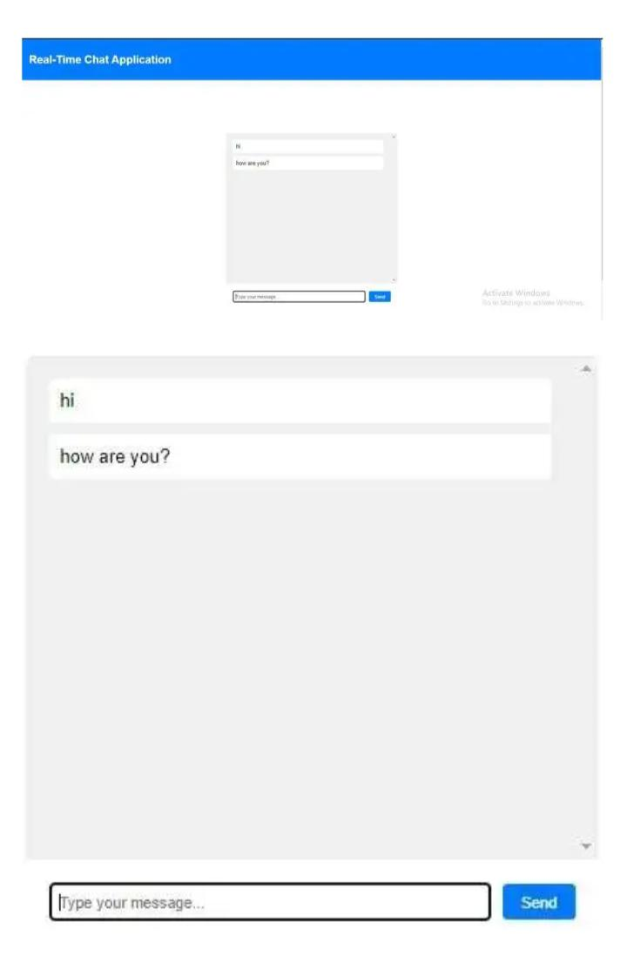
Output:

Slide 12
Conclusion
Chat Connect has been successfully developed as a real-time communication app, aiming to provide users with seamless, instant messaging experiences.
By integrating advanced features like secure encryption, user-friendly interfaces, and personalized settings, the app offers an ideal platform for both casual and professional conversations.
As the project moves forward, the focus will be on continuous improvement, incorporating user feedback, expanding the feature set, and ensuring robust scalability to support growing user bases.
Future versions will also explore enhanced AI-driven functionalities, improved security protocols, and further platform integrations to maintain competitiveness in the evolving communication app market.

